Slide 1

Department Of Electronics and Telecommunication EngineeDDepartement Of Electronics & Telecommunication
TAE:1
Subject: ROBOTICS (UECL421)
Topic: Robots in Defense and Military
Professor : Dr.Abhijit Titarmare
By....
Abhirat Bawane A-19
Yatharath Punjekar A-62

Slide 2
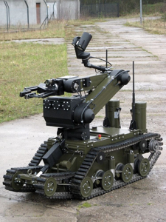
Introduction to Robots in Defense and Military
Robots are increasingly integrated into modern military operations to enhance capabilities and reduce human risk.
They perform a variety of roles, from reconnaissance to combat support.
The development of military robots is driven by technological advancements and strategic needs.
Notes:
Image source: https://media.defense.gov

Slide 3
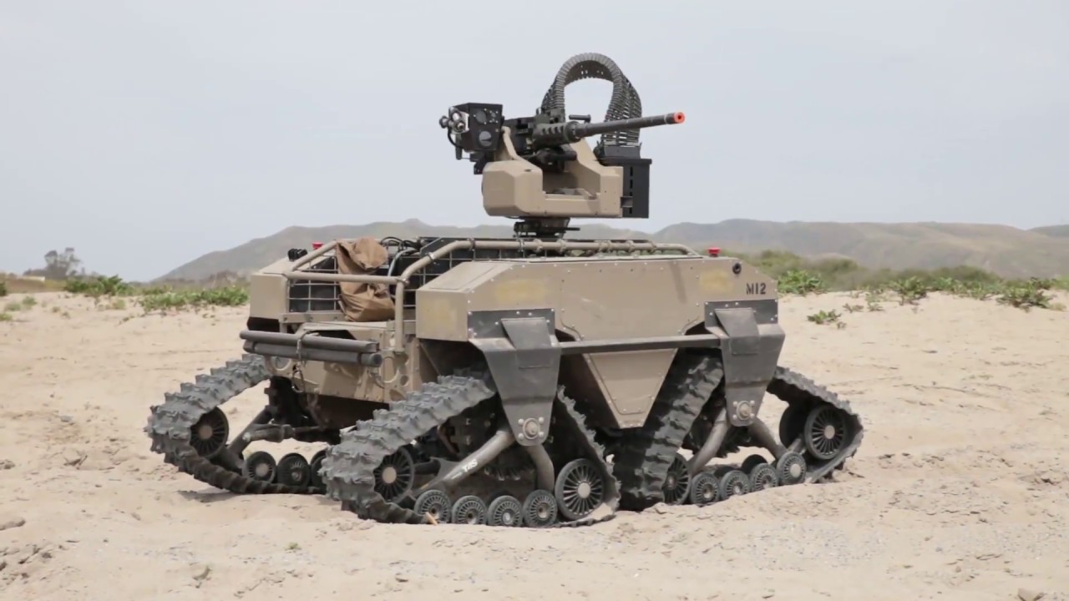
Types of Military Robots
Unmanned Ground Vehicles (UGVs)
An Unmanned Ground Vehicle (UGV) is a robotic vehicle that operates on the ground without a human operator onboard. It can be controlled remotely or operate autonomously using artificial intelligence and sensors. UGVs are widely used in sensors. UGVs are widely used in military applications to carry out dangerous or repetitive tasks without risking human operates on the ground without a human operator onboard. It can be controlled remotely or operate autonomously using artificial intelligence and sensors. UGVs are widely used in military applications to carry out dangerous or repetitive tasks without risking =carry out dangerous or repetitive tasks without risking human lives.
An Unmanned Ground Vehicle (UGV) is a robotic vehicle that operates on the ground without a human operator onboard. It can be controlled remotely or operate autonomously using artificial intelligence and sensors. UGVs are widely used in military applications to carry out dangerous or repetitive tasks without risking human lives.
Notes:
Image source: https://img.militaryaerospace.com

Slide 4
Working
An Unmanned Ground Vehicle (UGV) is a robotic vehicle that operates on the ground without a human operator onboard. It can be controlled remotely or operate autonomously using artificial intelligence and sensors. UGVs are widely used in sensors. UGVs are widely used in military applications to carry out dangerous or
Remote Control and Autonomous Operation: UGVs can be controlled by a human operator via a command console or control station that receives live video and sensor data. More advanced UGVs use onboard Artificial Intelligence (AI) and sensors to navigate and complete missions with minimal human intervention, such as avoiding obstacles and following predetermined routes.
Sensors and Cameras: UGVs are equipped with multiple sensors including high-resolution cameras, thermal imaging, infrared sensors, LiDAR, radar, and others to detect terrain, obstacles, targets, and threats in real time. This sensor suite provides crucial battlefield intelligence and situational awareness for operators or onboard AI systems.
Mobility and Terrain Navigation: UGVs use wheels, tracks, or legs designed to traverse difficult, uneven, or hazardous terrain that may be inaccessible to humans or manned vehicles. Advanced autonomous UGVs use sensor data and AI algorithms for path planning, obstacle avoidance, and terrain adaptation to navig without risking human operates on the ground.
Notes:
Image source: https://img.militaryaerospace.com

Slide 5
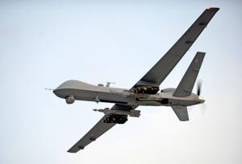
Types of Military Robots
Unmanned Ariel Vehicles (UAV)
An Unmanned Ground Vehicle (UGV) is a robotic vehicle that operates on the ground without a human operator onboard. It can be controlled remotely or operate autonomously using artificial intelligence and sensors. UGVs are widely used in sensors. UGVs are widely used in military applications to carry out dangerous or repetitive tasks without risking human operates on the ground without a human operator onboard. It can be controlled remotely or operate autonomously using artificial intelligence and sensors. UGVs are widely used in military applications to carry out dangerous or repetitive tasks without risking =carry out dangerous or repetitive tasks without risking human lives.
An Unmanned Aerial Vehicle (UAV), commonly known as a drone, is a pilotless aircraft used extensively in military operations. It can be remotely controlled or operate autonomously using onboard sensors and AI systems. UAVs play a critical role in modern warfare by performing a variety of vital functions without risking human pilots.
Notes:
Image source: https://img.militaryaerospace.com

Slide 6
Working
An Unmanned Aerial Vehicle (UAV), or drone, works through a combination of remote control, autonomous systems, sensors, actuators, communication links, and onboard software that together enable it to perform military and surveillance tasks without a human pilot onboard.
=carry out dangerous or repetitive tasks without risking human lives.
Control System:
UAVs can be remotely controlled by an operator via a ground control station (GCS) or can fly autonomously using pre-programmed flight paths and onboard autonomy software.
Control signals direct the UAV’s speed, direction, altitude, and mission tasks.
Sensors:
UAVs are equipped with position and movement sensors such as gyroscopes, accelerometers, compasses, barometers, and GPS to maintain stable flight and navigation.
They also carry external sensors like high-resolution RGB cameras, infrared/thermal imagers, LiDARs, and radar to surveil, target, or map terrain.
Sensors provide real-time data for piloting and mission execution, including collision avoidance.
Actuators:
These include electronic speed controllers that regulate motor speed, servomotors to adjust control surfaces on fixed-wing UAVs or rotors on helicopters/multirotors, and other payload mechanisms like cameras or weapons.
Notes:
Image source: https://img.militaryaerospace.com

Slide 7
Artificial intelligence enables autonomous decision-making and navigation.
Sensors and cameras provide real-time data and environmental awareness.
Robotics hardware is designed for durability, adaptability, and stealth in combat environments.
Notes:
Image source: https://insights.sei.cmu.edu

Slide 8
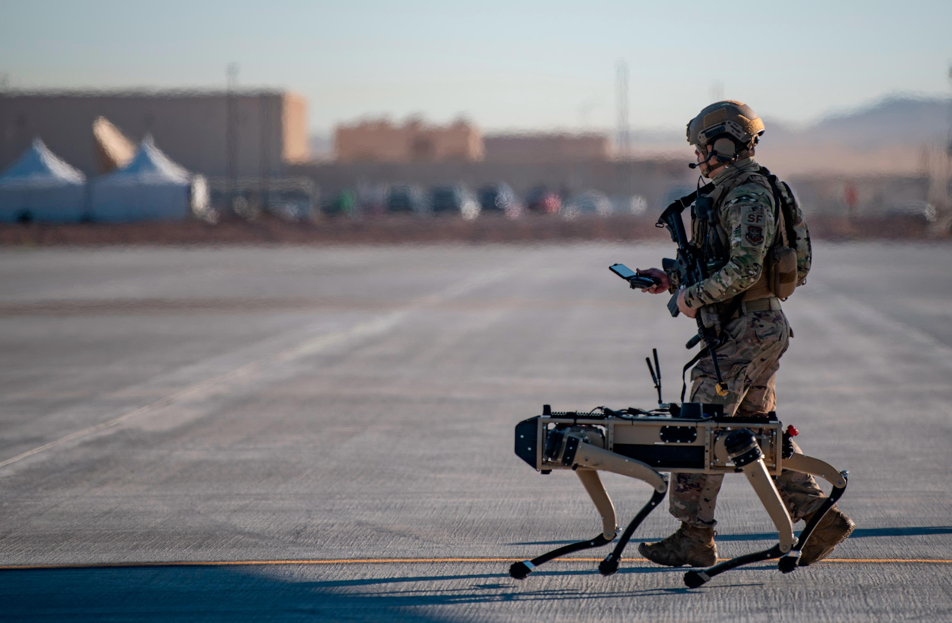
Advantages of Military Robots
They reduce human casualties by taking on dangerous tasks.
Robots can operate continuously without fatigue, increasing operational time.
They provide high precision and can execute complex missions with accuracy.
Notes:
Image source: https://media.defense.gov

Slide 9
Applications of Military Robots
Reconnaissance robots gather intelligence in hostile territories without risking soldiers’ lives.
Explosive Ordinance Disposal (EOD) robots neutralize bombs and mines safely.
Combat robots can engage targets directly, supporting infantry operations.
Notes:
Image source: https://media.cnn.com

Slide 10
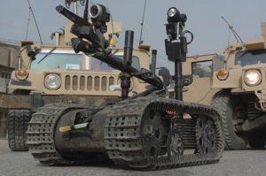
Conclusion
Military robotics are transforming defense strategies with increased efficiency and safety.
Ongoing technological and ethical challenges must be addressed to ensure responsible use.
The future of military robots promises greater autonomy, sophistication, and integration in warfare.
Notes:
Image source: https://media.defense.gov

